Slide 1
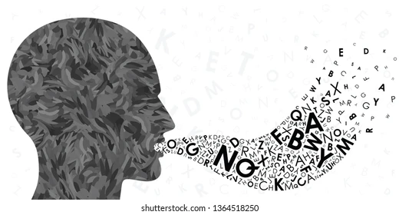
TEXT TO AUDIO CONVERSION

Slide 2


VISVESVARAYA TECHNOLOGICAL UNIVERSITY
BELAGAVI – 590018, Karnataka
AMC ENGINEERING COLLEGE
Department of Data Science
Accredited by NBA, New Delhi
AMC Campus, Bannerghatta Rd, Bengaluru, Karnataka-560083
Subject: Introduction to Python (ProgrammingBPLCK105B/205B)
TOPIC: Text to Audio Conversion
Unnati Saxena 1AM23CD114
Rishitha HMR 1AM23CD088
Srushti Patil 1AM23CD106
Tharika B. 1AM23CD112
Vaishnavi N. 1AM23CD065

Slide 3


In today's globalized world, the ability to
communicate across language barriers is
increasingly important. This is where the text
translation and text-to-speech (TTS)
technologies come into play. These technologies enab
enable seamless communication by translating
text from one language to another and
converting written text into spoken words.
TEXT TO AUDIO CONVERSION

Slide 4
Tech Stack for Text to Audio Conversion
Python 3.0
GoogleTrans library
gTTS
This is a Python library that interfaces with Google Translate to translate text from one language to another. It handles the translation functionality. - Import: from googletrans import Translator
This library converts text into speech using Google Text-to-Speech API. It handles the text-to-speech functionality. - Import: from gtts import gTTS
The primary programming language used for writing the script.
Jupyter Notebook
os Module
IPython.display Module
This is a standard Python library for interacting with the operating system, used here to get the absolute path of the saved audio file. - Import: import os
This is part of the IPython library, which provides rich display capabilities in Jupyter notebooks. It's used to play audio files within the notebook. - Import: from IPython.display import Audio, display
The script is designed to be run in a Jupyter notebook environment, especially because it uses IPython.display.Audio to play the audio file.

Slide 5
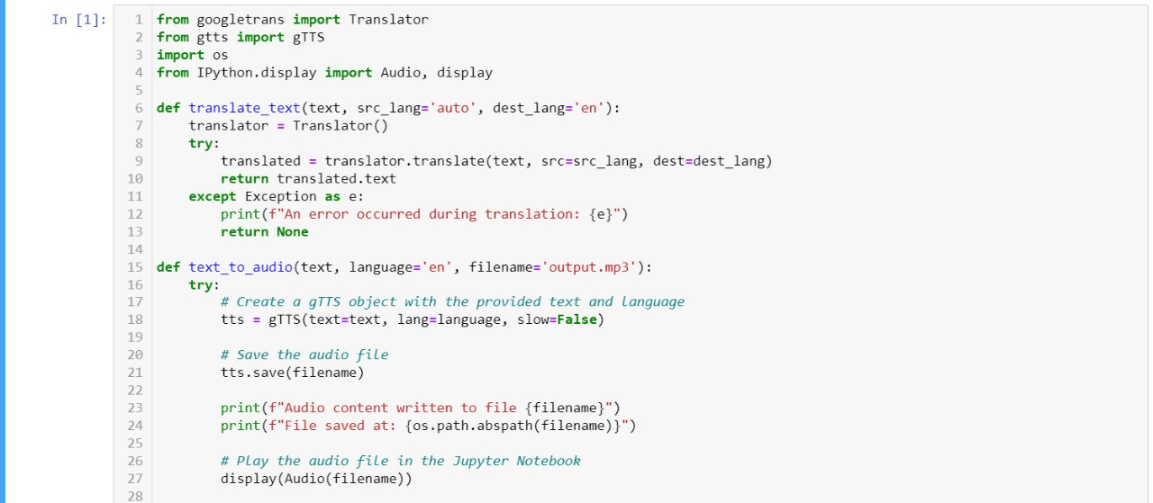
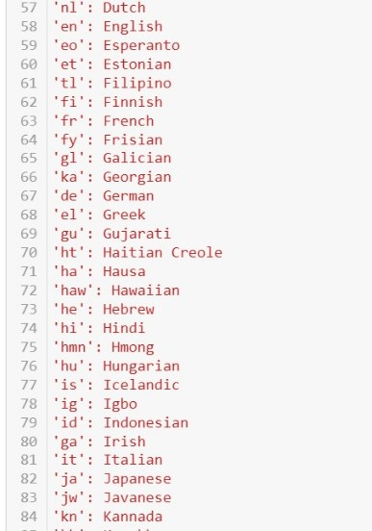
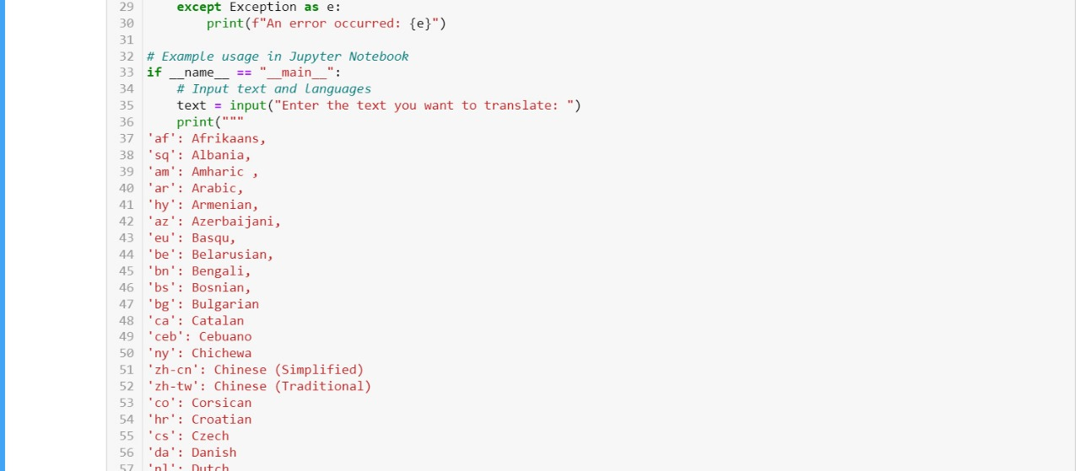
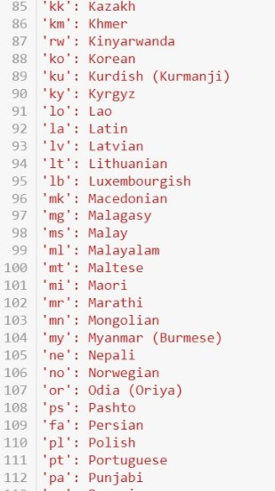
MODEL
Credits: Unnati Saxena

Slide 6
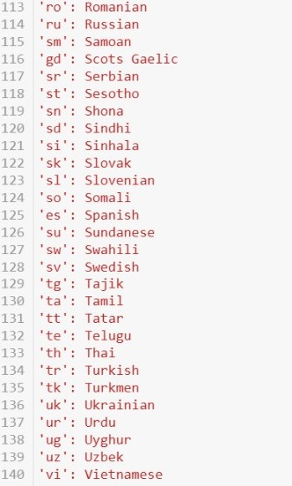
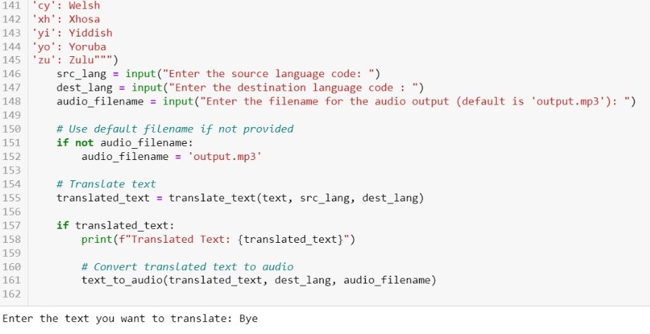
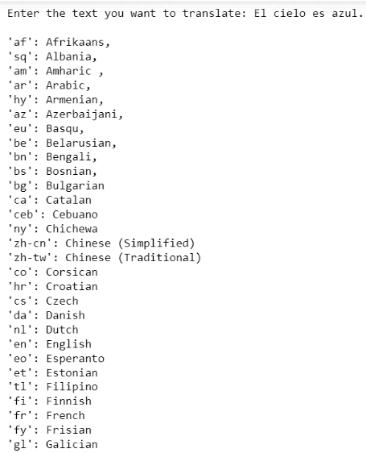
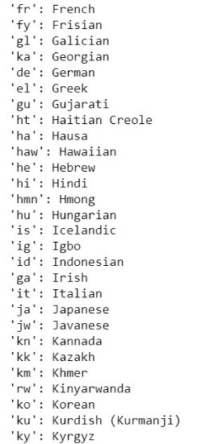
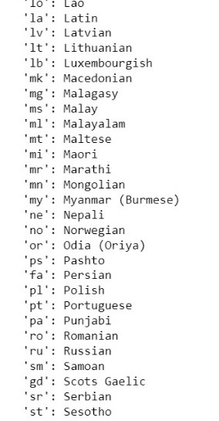
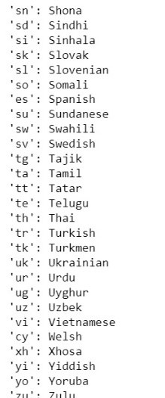
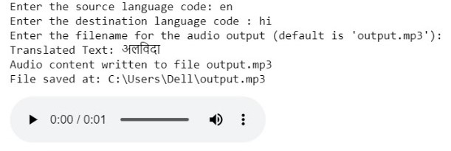
MODEL
OUTPUT
Credits: Unnati Saxena

Slide 7
ADVANTAGES
Enhanced Language Learning
Accessibility
Global Communication
Educational Resource
Ease of Use
Wide Language Support
Immediate Feedback

Slide 8
DISADVANTAGES
Translation Accuracy
.Audio Quality and Customization
Language Support Limitations
Dependence on Internet Connection
Context and Ambiguity

Slide 9
CONCLUSION
In conclusion, the translation and text-to-speech project has successfully introduced a practical and effective tool for overcoming language barriers and enhancing accessibility through technology. Its current achievements lay a strong foundation for future enhancements and broader applications, promising continued innovation in language learning, communication, and inclusivity. By addressing ongoing challenges and leveraging emerging technologies, the project aims to make significant contributions to global communication and accessibility efforts in the years to come.

